Slide 1

DEliVERiNGSKiLLS
DRiViNGSUCCESS
www.VINSYS.COM

Slide 2
Components of database

Slide 3
Hardware, Software, Data, Database Access Language, Procedures and Users all together form the components of a DBMS.

Slide 4
Hardware
The hardware is the actual computer system used for keeping and accessing the database. The conventional DBMS hardware consists of secondary storage devices such as hard disks. Databases run on the range of machines from micro computers to mainframes.

Slide 5
Software
Software is the actual DBMS between the physical database and the users of the system. All the requests from the user for accessing the database are handled by DBMS.

Slide 6
Data
It is an important component of the database management system. The main task of DBMS is to process the data. Databases are used to store the data, retrieved, and updated to and from the databases.

Slide 7
Users
There are a number of users who can access or retrieve the data on demand using the application and the interfaces provided by the DBMS.
The users of the database can be classified into different groups −
Native Users
Online Users
Sophisticated Users
Specialized Users
Application Users
DBA- Database Administrator

Slide 8
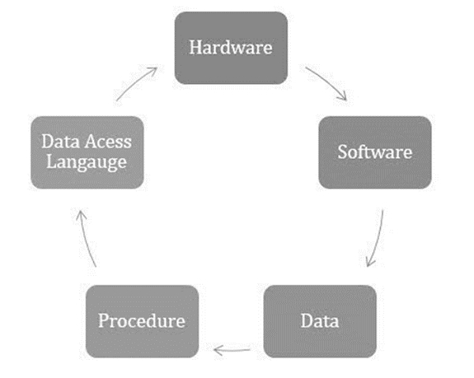
The components of DBMS are given below in pictorial form −

Slide 9
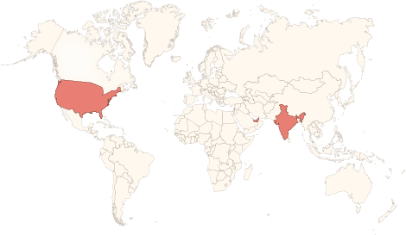






Physical Presence
www.vinsys.com
enquiry@vinsys.com
Shivaji Niketan, Tejas Society, Behind Kothrud Bus Stand, Near Mantri Park, Kothrud, Pune - 411029.
304, City Tower 2, Near Crown Plaza, Sheikh Zayed Road. Dubai, UAE.
PO.Box - 213279
132 West 31st Street, First Floor, New York, 10001, USA

